Slide 1
Wheels On Rent
A Java Swing Application for Booking Vehicles
Group 21
Akshay Ram M Pai
Adarsh P Vinod
Ameer Nizar

Slide 2
Introduction - Project Overview
The Problem:
The market for vehicle rentals is fragmented.
Users often need different apps for cars, bikes, or scooters.
There is a need for a single, simple, and reliable desktop application that manages the entire booking process from selection to confirmation.
The Solution:
A complete desktop application built using Java Swing.
Our system provides a seamless, end-to-end user experience, allowing users to select, book, and confirm a vehicle rental in one continuous workflow.
Core Objective:
To design and implement a robust application that handles vehicle selection, dynamic pricing, user authentication, and a simulated payment process, all linked to a persistent MySQL database.

Slide 3
Introduction - Technology Stack
Frontend (GUI): Java Swing
Why? A powerful, platform-independent toolkit for building rich desktop applications.
Key Components Used: JFrame (for all windows), JTabbedPane (to categorize vehicles), JPanel & GridBagLayout (for clean, responsive layouts), JSpinner (for time), and custom-built JDialog components (for the calendar picker).
Backend (Logic): Java (JDK)
Why? A robust, object-oriented language to manage all business logic, event handling, and data validation.
Role: All ActionListener events, price calculations, and date/time logic are handled by Java.
Database Connectivity: JDBC (Java Database Connectivity)
Why? The standard Java API that acts as the "bridge" between the Java application and the database, allowing us to send SQL queries and receive results.
Database (Storage): MySQL
Why? A fast, reliable, and open-source Relational Database Management System (RDBMS).
Role: Used to store all persistent data in two main tables:
users: Stores customer registration data, including credentials and KYC info.
bookings: Stores details of every rental (vehicle type, dates, etc.).

Slide 4
Booking Initiation
Intuitive Date/Time Selection:
Instead of error-prone text fields, we implemented a modern, visual date picker.
A custom, modal JDialog calendar (CalendarDialog.java) provides a professional, user-friendly way to select dates.
JSpinner components are used for precise time (HH:mm) selection.
Initial Validation:
The system performs an initial check to ensure the drop-off date/time is after the pickup date/time, preventing invalid booking attempts early in the process.
Database Integration:
Upon clicking "Book Dates," the system provisionally creates a new record in the bookings table in MySQL.
This "pre-booking" step secures the selected times and passes the booking details to the next stage of the workflow.

Slide 5
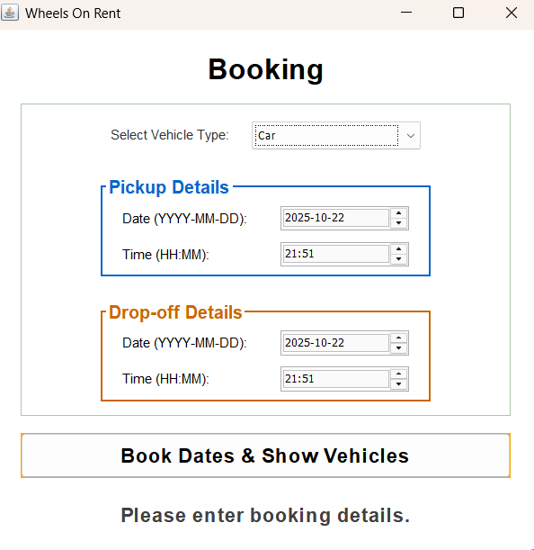
Booking Initiation

Slide 6
Dynamic Vehicle Catalog
Categorized & Tabbed Display:
To avoid overwhelming the user, vehicles are cleanly sorted into categories using a JTabbedPane (e.g., "Sedan," "SUV," "Hatchback").
The entire interface is built with Swing’s Grid Layout to for a modern aesthetic.
Dynamic Price Calculation:
This is the core business logic. The price is not static.
The system calculates the total rental duration in days (rounding up any partial day to a full 24-hour period).
Formula: Total Price = Base Daily Rate * Total Days
This is calculated in real-time for every vehicle card displayed.
Data-Driven UI:
The vehicle models and their base prices are stored in LinkedHashMap data structures. This allows for easy updates and preserves the order of display.
The loadScaledIcon method dynamically loads vehicle images, or provides a getPlaceholderIcon if an image is missing, ensuring the UI never breaks.

Slide 7
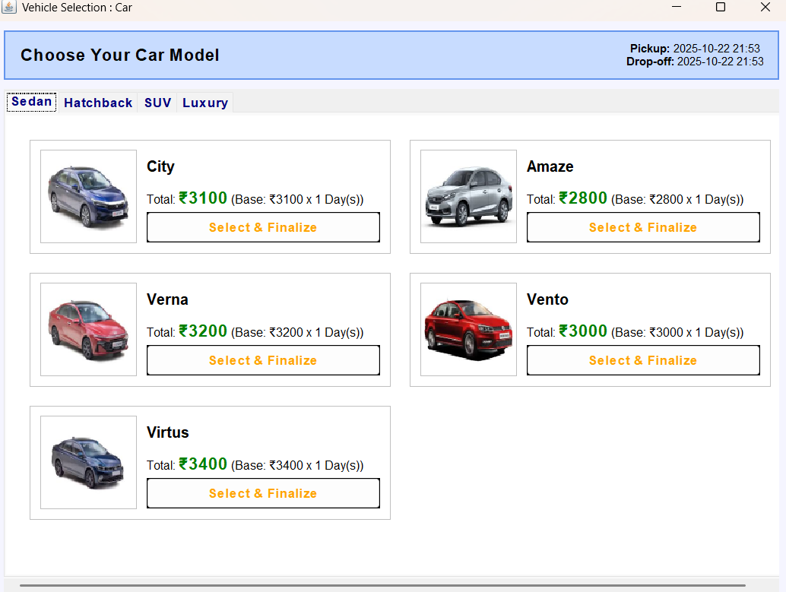
Dynamic Vehicle Catalog

Slide 8
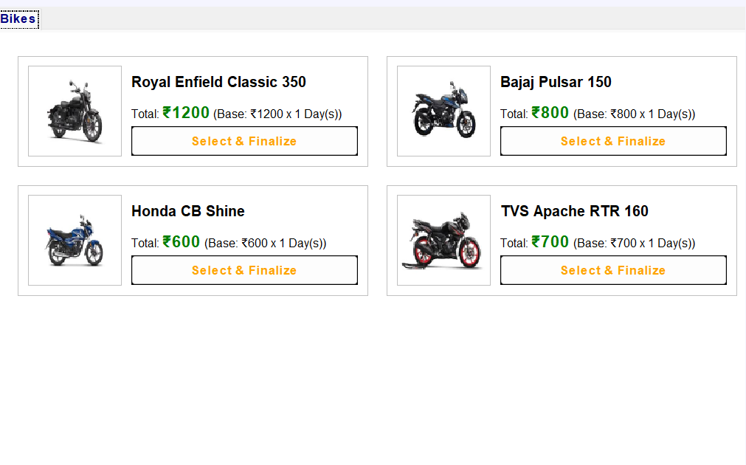
Dynamic Vehicle Catalog

Slide 9
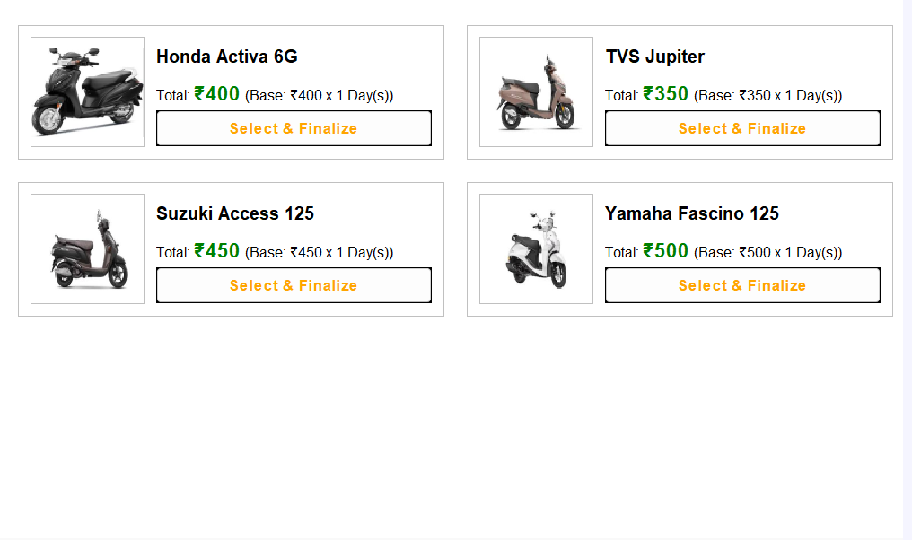
Dynamic Vehicle Catalog

Slide 10
Secure Authentication
Modular Authentication Flow:
After selecting a vehicle, the user is directed to an authentication portal (BookingConfirmationGUI).
This screen clearly presents two distinct paths: Register (for new users) or Log In (for existing users).
New User Registration (KYC):
The registration form (RegistrationGUI.java) collects all necessary "Know Your Customer" (KYC) details: Name, Email, Age, License Number, Aadhar Number, and Phone.
The MySQLAuthUtil.registerUser() method inserts this data into the users table.
The database enforces a UNIQUE constraint on the email field to prevent duplicate accounts.
Existing User Login:
The login form (LoginGUI.java) validates credentials using the MySQLAuthUtil.authenticateUser() method.
Logic: SELECT name FROM users WHERE email = ? AND password_hash = ?
Project Demo Feature: A test user (project@test.com / secure123) is automatically inserted only when the LoginGUI is opened, guaranteeing a successful login path for demonstration.

Slide 11
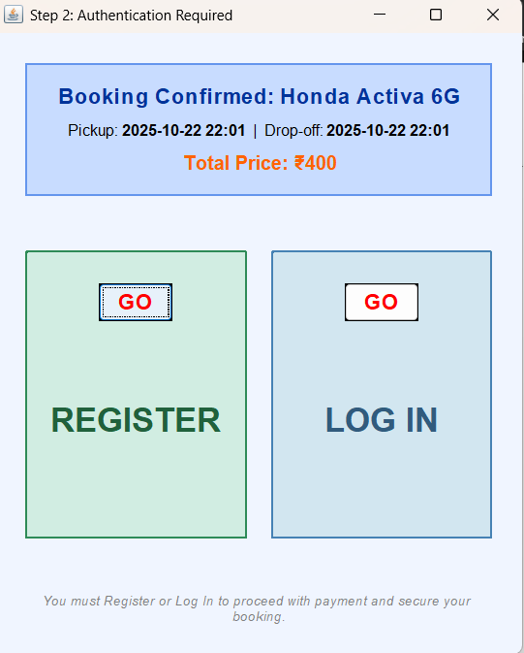
Secure Authentication

Slide 12
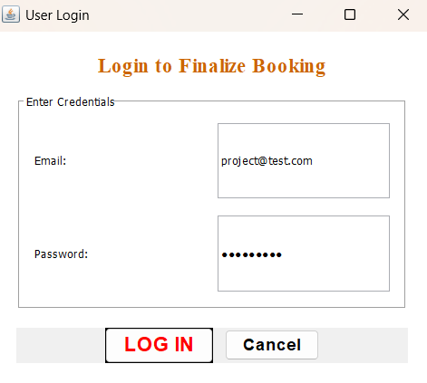
Secure Authentication(Login)

Slide 13
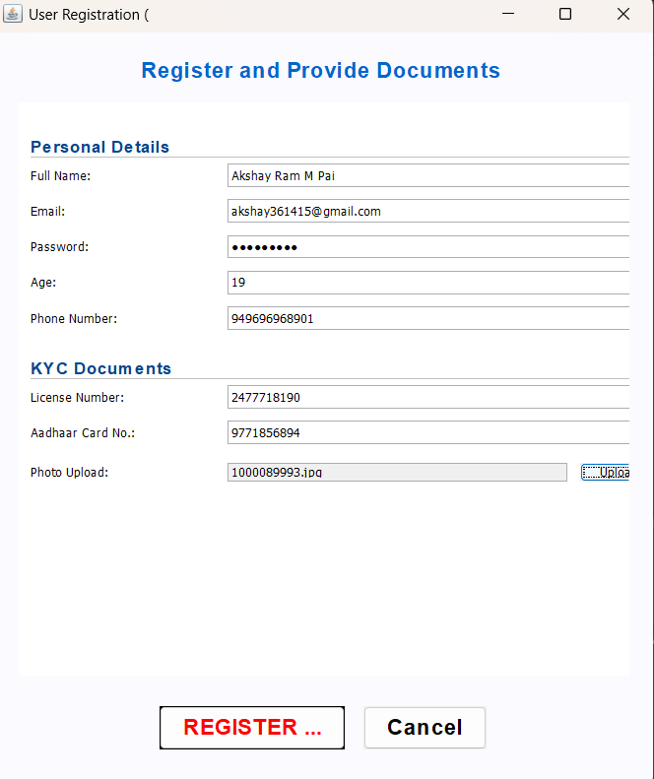
Secure Authentication(Register)

Slide 14
Booking Finalization
Final Booking Review:
Before payment, the PaymentConfirmationGUI aggregates all data for one final check: Authenticated User, Vehicle Image & Model, Pickup/Drop-off Times, and Final Calculated Price. [Include screenshot of the Payment Review screen]
Simulated UPI Payment:
To demonstrate a complete payment flow without complex APIs, a payment simulation is used.
Clicking "Proceed to Payment" opens a modal dialog showing a placeholder UPI QR code (upi_qr_code.png).
A "Simulate Successful Payment" button mimics a successful bank transaction.
Final Receipt & Window Management:
Upon successful simulation, the payment window is disposed (not just hidden) to prevent window clutter.
A final, clean receipt (FinalConfirmationGUI) is displayed, providing the user with all booking info, the static pickup address, and a support phone number. [Include screenshot of the Final Receipt screen]

Slide 15
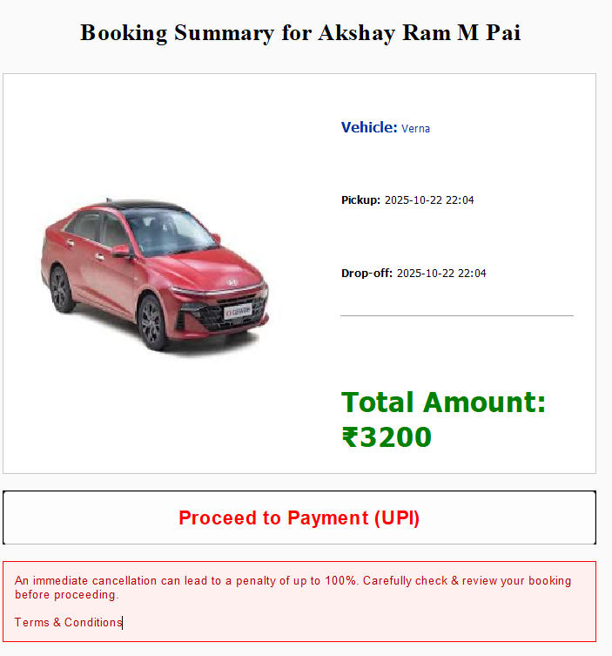

Slide 16
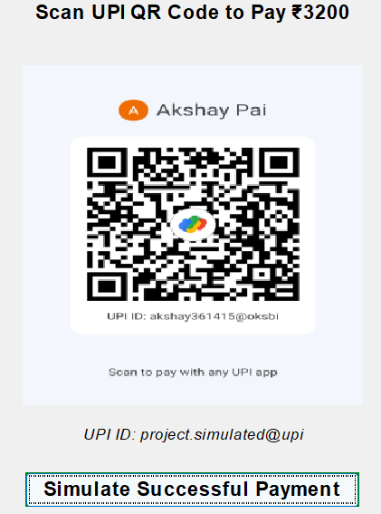
Payment Gateway(UPI)

Slide 17
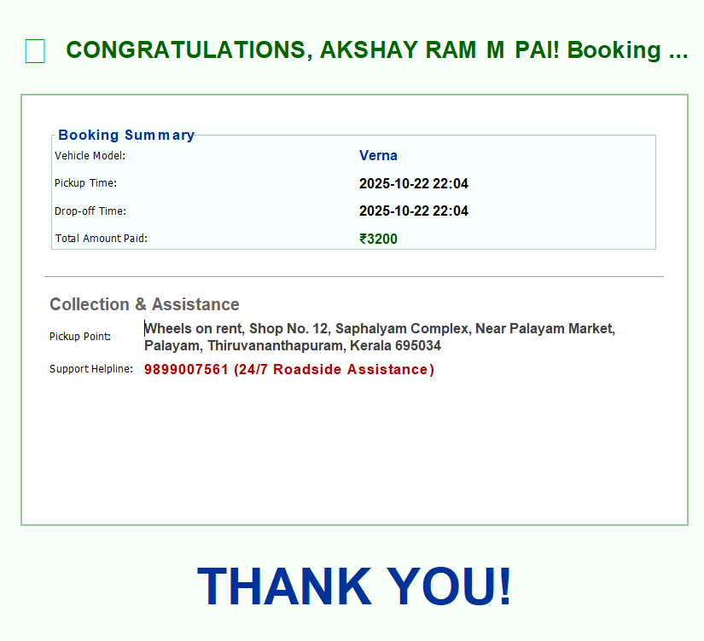
Final Confirmation

Slide 18
Conclusion & Future Scope
Project Summary:
We successfully developed a full-stack Java Swing application that manages the entire vehicle rental process.
The project demonstrates a clear understanding of OOP principles, Swing GUI design, JDBC connectivity, and MySQL database management.
Future Scope (Potential Improvements):
Real-time Availability: Implement logic to check the bookings table and disable/hide vehicles that are already booked for the selected time range.
Secure Passwords: Implement password hashing (e.g., SHA-256 or bcrypt) instead of storing plaintext passwords (a known limitation for this project).
User Profiles: Allow logged-in users to view their booking history.
Real Payment API: Integrate a real payment gateway like Stripe or Razorpay.

Slide 22
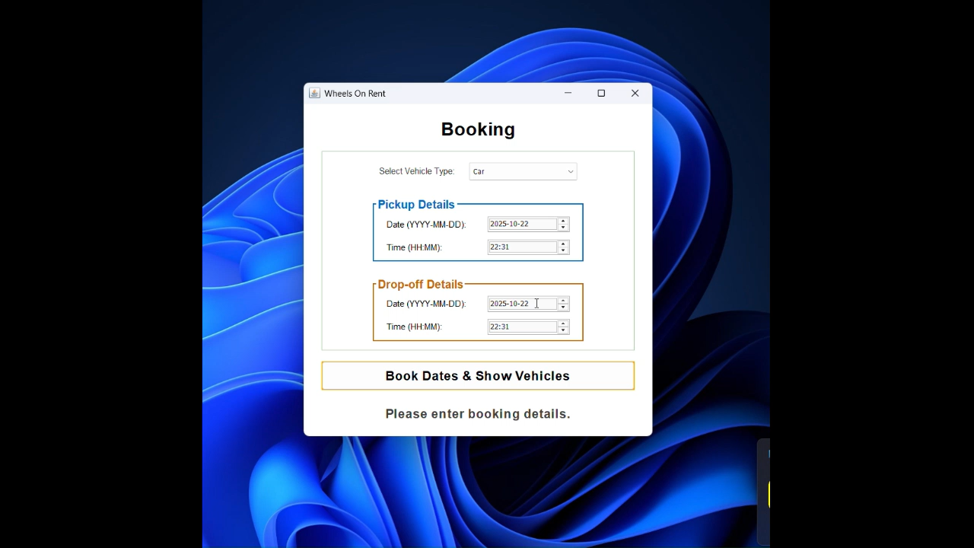

Slide 23
THANK YOU

